Slide 1
Digital Portfolio
STUDENT NAME: Indhumathi L
REGISTER NO AND NMID:2422k0922/2C2B9825505C490ACDE49921DE2C058D
DEPARTMENT: Bsc. Computer Science
COLLEGE: COLLEGE/ UNIVERSITY:Tiruppur Kumaran College For women/Bharathiyar University

Slide 2
PROJECT TITLE
MY CRAFT FOR PORTFOLIO

Slide 3


AGENDA
Problem Statement
Project Overview
End Users
Tools and Technologies
Portfolio design and Layout
Features and Functionality
Results and Screenshots
Conclusion
Github Link
3/21/2024 Annual Review

Slide 4

PROBLEM STATEMENT
A navigation bar with links to About, Gallery, and Contact sections.
A gallery displaying 3 crafts with images and descriptions.
A contact form with validation using JavaScript to show success or error messages.
Responsive CSS styling with a clean, warm visual design.

Slide 5

PROJECT OVERVIEW
A simple portfolio website built with HTML, CSS, and JavaScript to showcase handmade crafts. It includes an About section, a craft gallery, and a contact form with basic validation.

Slide 6

WHO ARE THE END USERS?
The end users of this craft portfolio website are:
Potential customers interested in buying handmade crafts
Craft enthusiasts looking for inspiration or ideas
Friends, family, or followers of the creator (Indhu Mathi) who want to explore her work
Event organizers or collaborators seeking to connect via the contact form

Slide 7

TOOLS AND TECHNIQUES
HTML – for structuring the webpage
CSS – for styling and responsive layout
JavaScript – for form validation and interactivity

Slide 8
POTFOLIO DESIGN AND LAYOUT
A clean, responsive layout with a navigation bar, About section, craft gallery in grid format, and a contact form. Styled with soft colors and modern design using CSS.
8

Slide 9
FEATURES AND FUNCTIONALITY
Responsive design with HTML & CSS
Craft gallery with images and descriptions
Contact form with JavaScript validation
Smooth navigation between sections

Slide 10
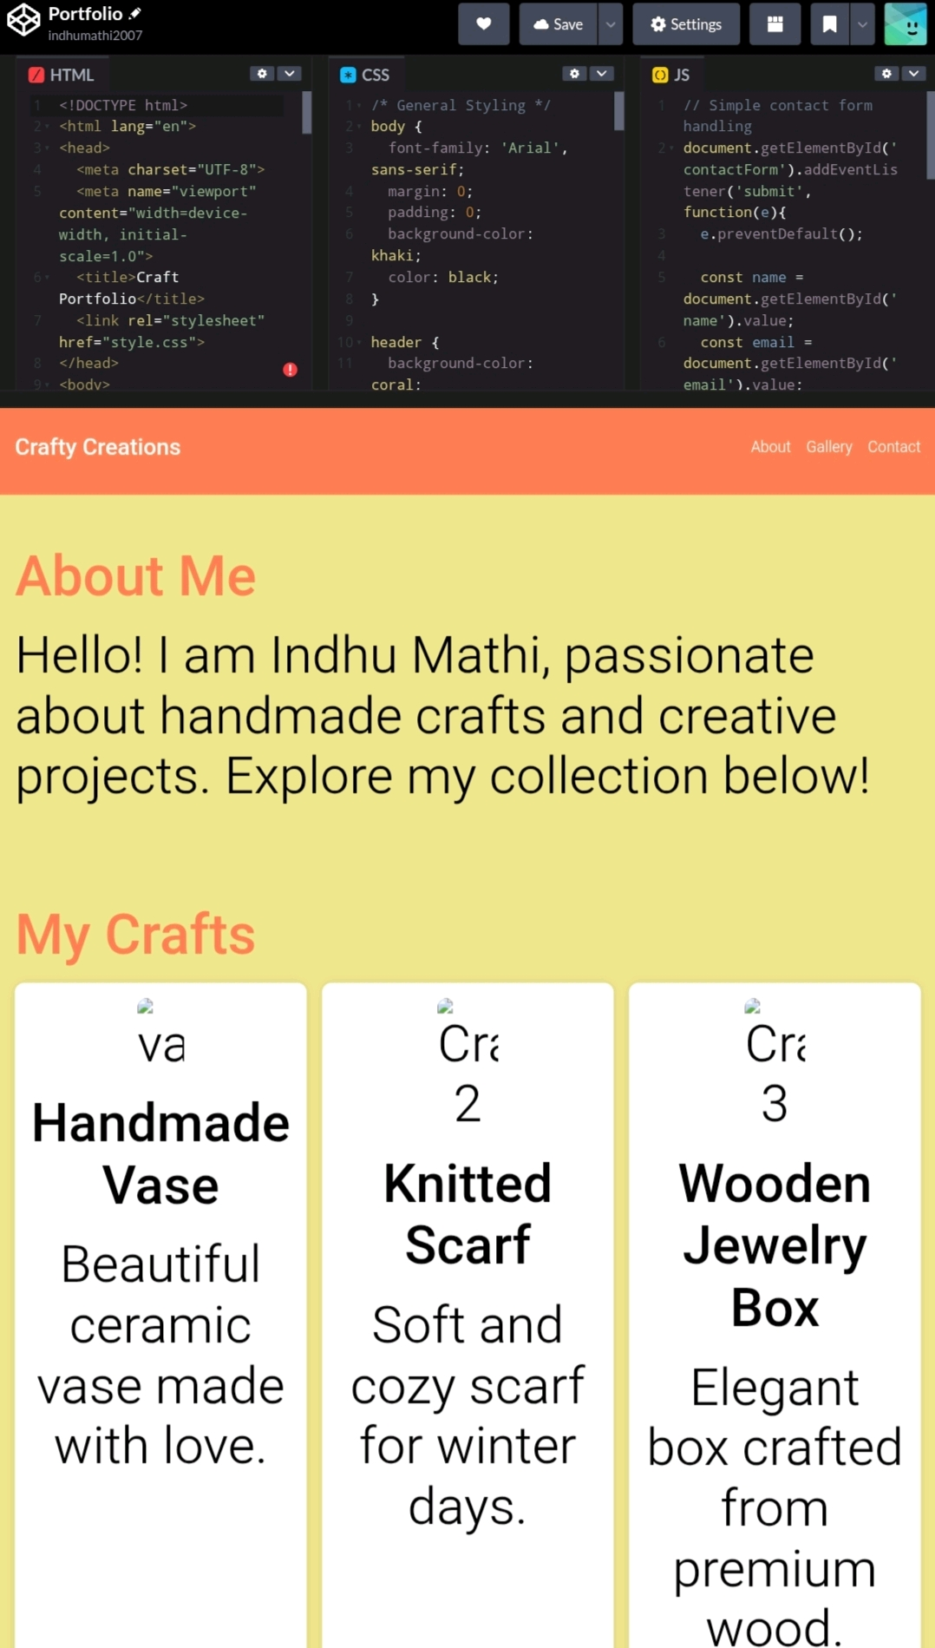
RESULTS AND SCREENSHOTS

Slide 11
CONCLUSION
This project demonstrates how HTML, CSS, and JavaScript can be used together to create a responsive, user-friendly craft portfolio website with interactive features.
11

